Slide 1
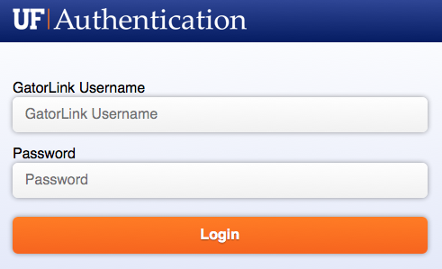
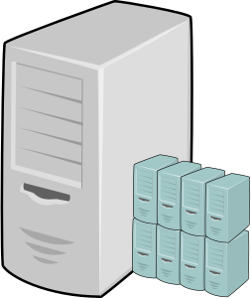
Put Service/Port/Protocol Here
Indicate data type and use
UFIT Database
Hosting
Put User Here
Put Application Database Here
Fiber Channel
Direct Connect
Put Service/Port/Protocol Here
Indicate data type and use
UFIT Archive Management
Put Application
Web Server Here
TSM
1501/TCP
Shibboleth
Put Service/Port/Protocol Here
Indicate data type and use
UFIT Storage Subsystem
Put User Here
FCoE
Authorization
Boundary
UFIT VMWare Cluster
Notes:
The area inside the authorization boundary and who is accessing the system from the Internet should be customized by the unit.

